Slide 1



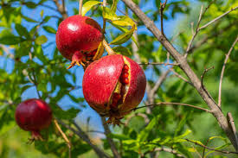

Presented by
Presented by
EDGE-BASED REAL-TIME POMEGRANATE DISEASE DETECTION AND PREDICTION USING SENSOR DATA AND WEATHER FORECAST INTEGRATION
Presented by :
Mentors :
Madhav Gaba
Shorya Gupta
Aman
Dr. Raman Goyal
Dr. Vivek Sethi
(CSED Department)

Slide 2

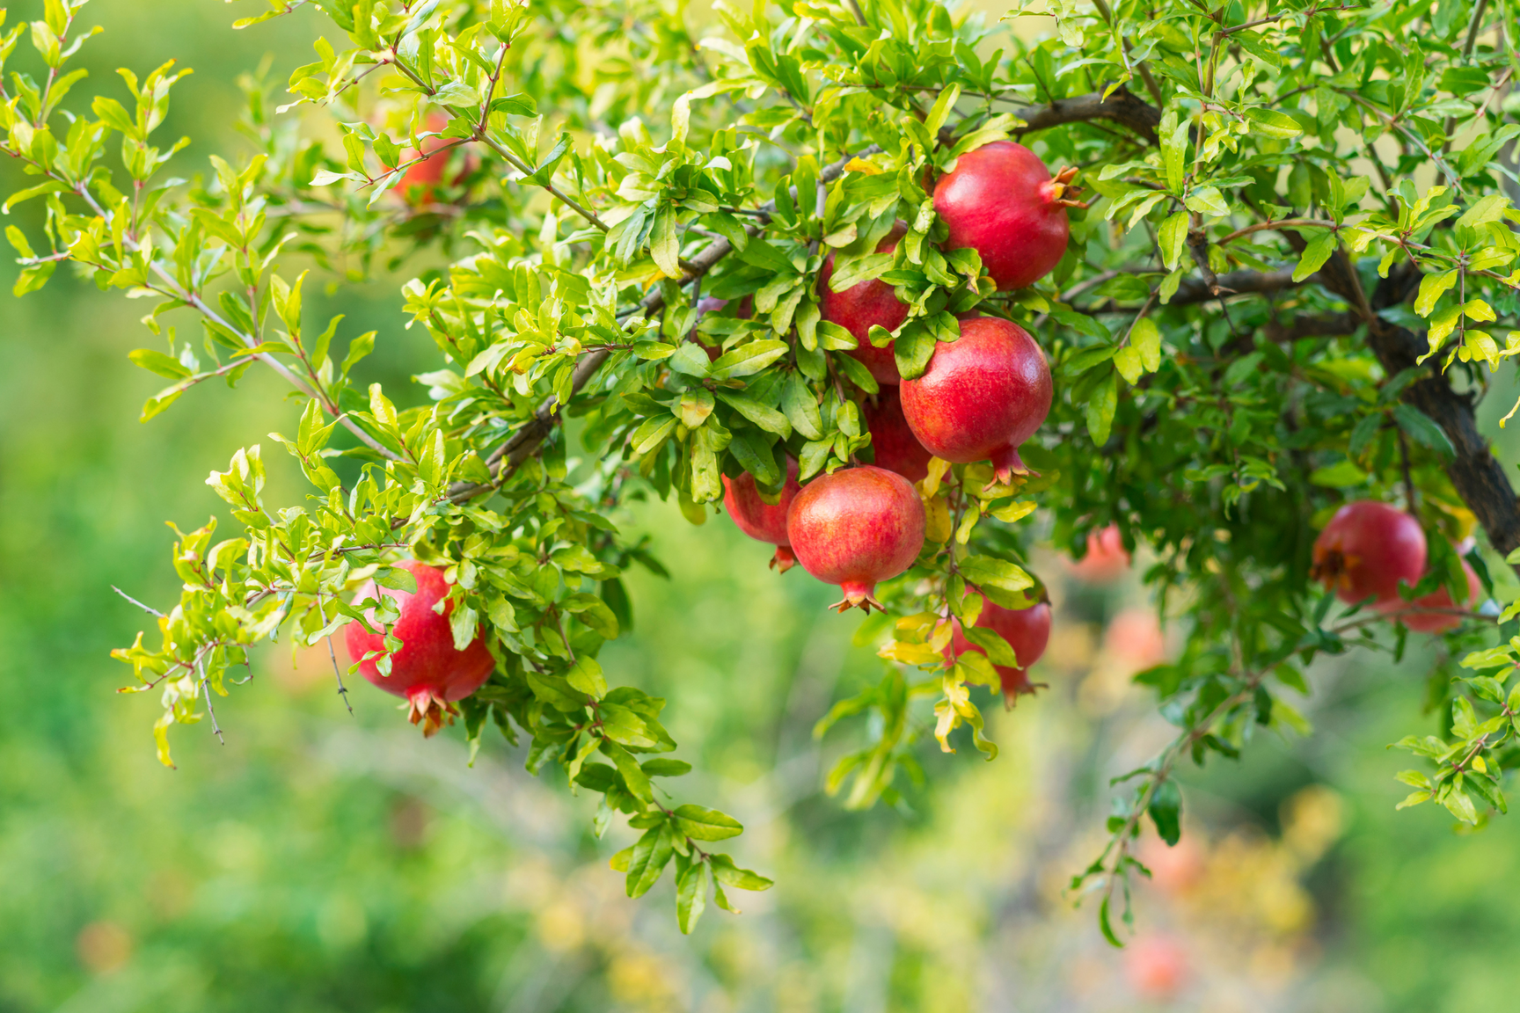


INTRODUCTION
Pomegranate cultivation is highly sensitive to environmental conditions, making early detection and prediction of diseases essential for minimizing crop loss and improving yield. This project presents an edge-based real-time system that integrates sensor data (such as temperature, humidity, and soil moisture) with weather forecast information to detect and predict pomegranate diseases at an early stage. By processing data locally at the edge, the system ensures low latency, quick decision-making, and reduced dependency on cloud infrastructure, making it ideal for remote agricultural environments.

Slide 3

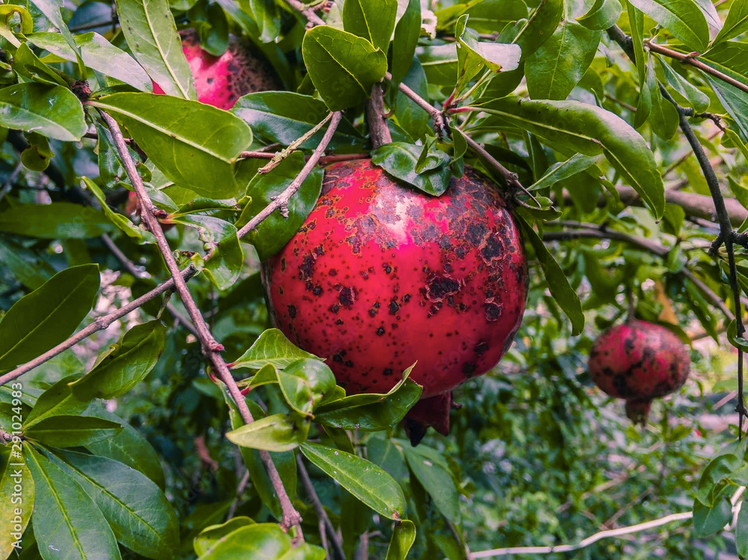
PROBLEM OVERVIEW
Pomegranate is a high-value fruit crop that contributes significantly to India’s horticultural exports. However, it is extremely vulnerable to fungal and bacterial diseases, especially during the monsoon and humid seasons. The major problem is that these diseases often go undetected until visible symptoms appear, by which time the infection has already spread—leading to significant crop loss and reduced market value. Farmers often rely on visual inspection or post-damage treatment, which is reactive, not preventive. Moreover, most small and marginal farmers lack access to expensive diagnostic labs, agronomists, or cloud-based platforms. This creates a critical gap in the agricultural ecosystem: the absence of an affordable, real-time, on-field solution for early disease detection and prediction.

Slide 4


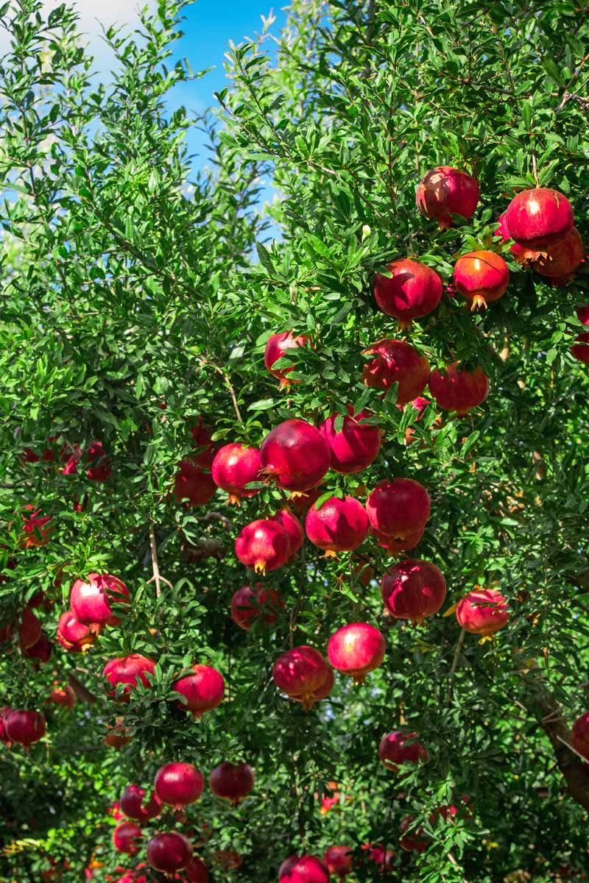

OBJECTIVES
To build a real-time, intelligent system for detecting pomegranate diseases and predicting them early — even before visible symptoms appear. This system leverages low-cost edge hardware, machine learning models, and environmental sensors to deliver timely alerts and actionable insights directly to farmers in the field.
By integrating leaf image analysis, soil and climate data, and weather forecasts, our goal is to minimize crop loss, reduce unnecessary pesticide usage, and improve decision-making at the grassroots level.
Predict potential disease outbreaks before symptoms appear, using sensor and weather data
Alert farmers with timely and actionable insights to enable early intervention
Use low-cost hardware like Raspberry Pi for offline, field-deployable processing

Slide 5
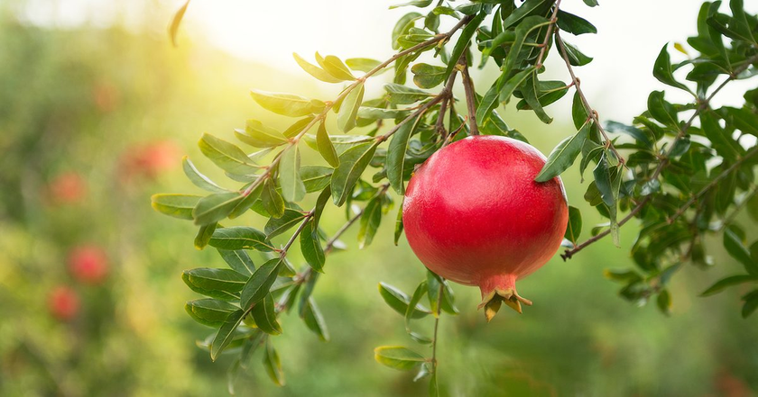
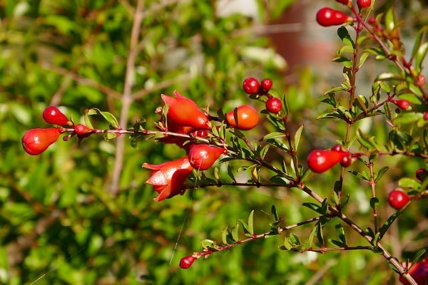
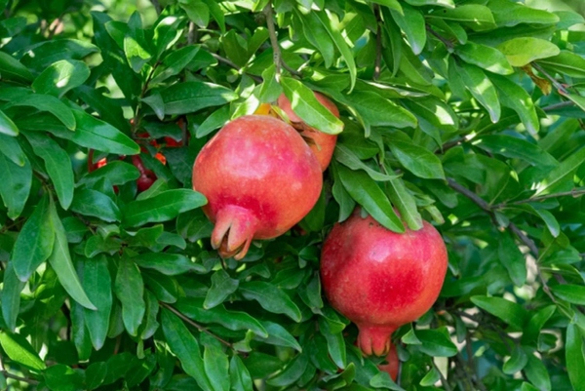
RESEARCH GAP
First, many disease detection models rely only on visual symptoms. But by the time symptoms appear, the infection is already spreading.
Second, existing models don’t integrate environmental risk factors — such as soil moisture, temperature, and humidity — which play a major role in disease development.
Third, very few systems are real-time, field-deployable, and affordable — especially for Indian farmers. They’re often cloud-dependent or need expensive hardware.

Slide 6
METHODOLOGY
DATA COLLECTION
Phase 1 :
Data Collection
Phase 2: Model 1
Real-Time Disease Detection
Phase 3:
Model 2 – Early Disease Prediction
Image Dataset Collection
Preprocessing & Augmentation
Feature
Engineering
Sensor Data
Logging
Train CNN Model (MobileNetV2)
Model Training
Weather API Integration
Model Conversion & Deployment
Deploy Forecasting Model

Slide 7

THANK YOU

